Slide 1
WordPress Migration for University Centers
Dominic Perrine

Slide 2
Process
Wireframe / Page design
Peer / Client Review
Publish and Clean Up SharePoint

Slide 3
Impact
Save $$
Experience with WordPress
UWSP Policies
Familiarity with Department
Modernized Website
Navigation / Accessibility
SEO
Condensed

Slide 4
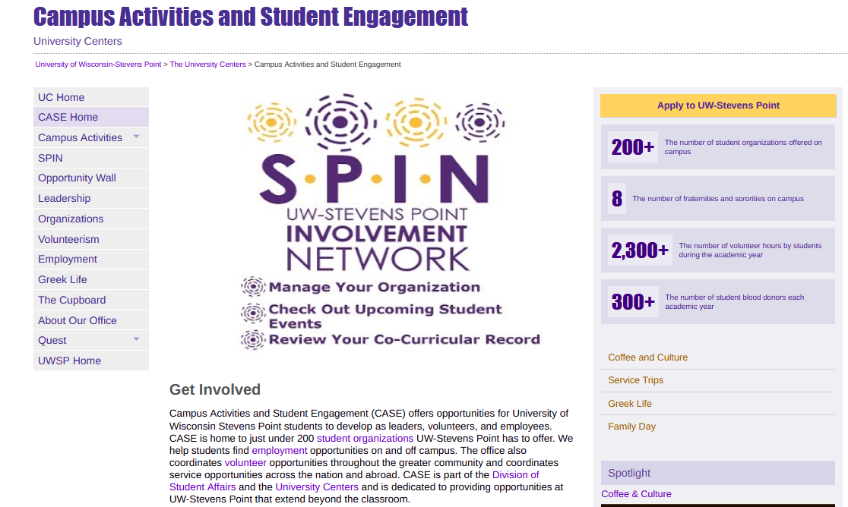
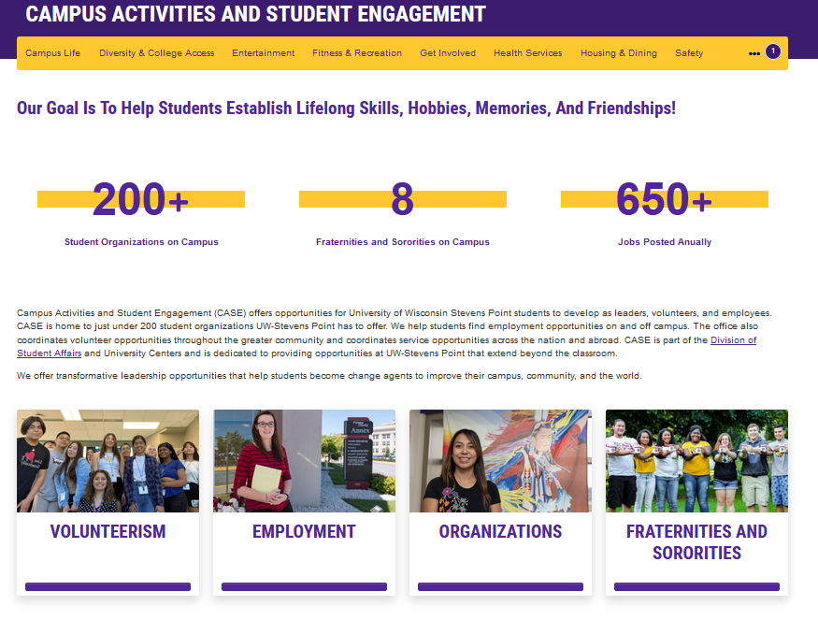
Redesign - CASE

Slide 5
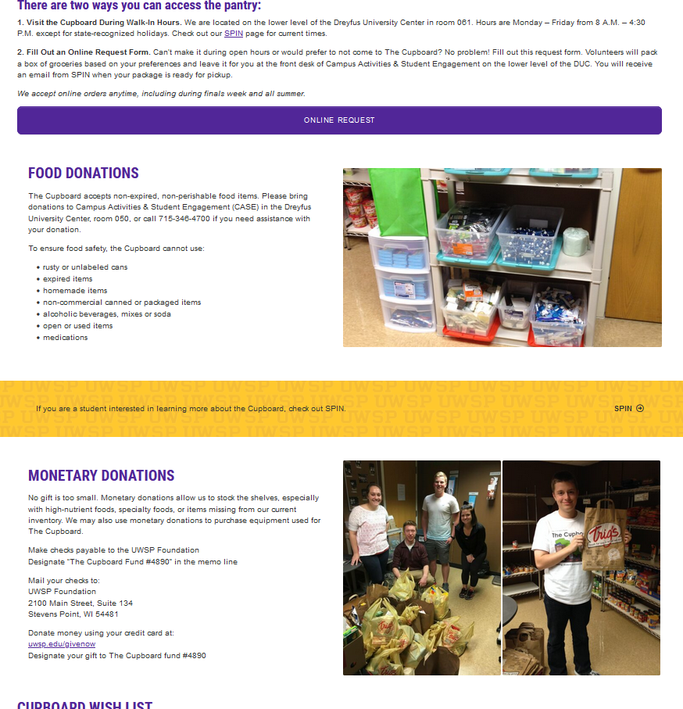
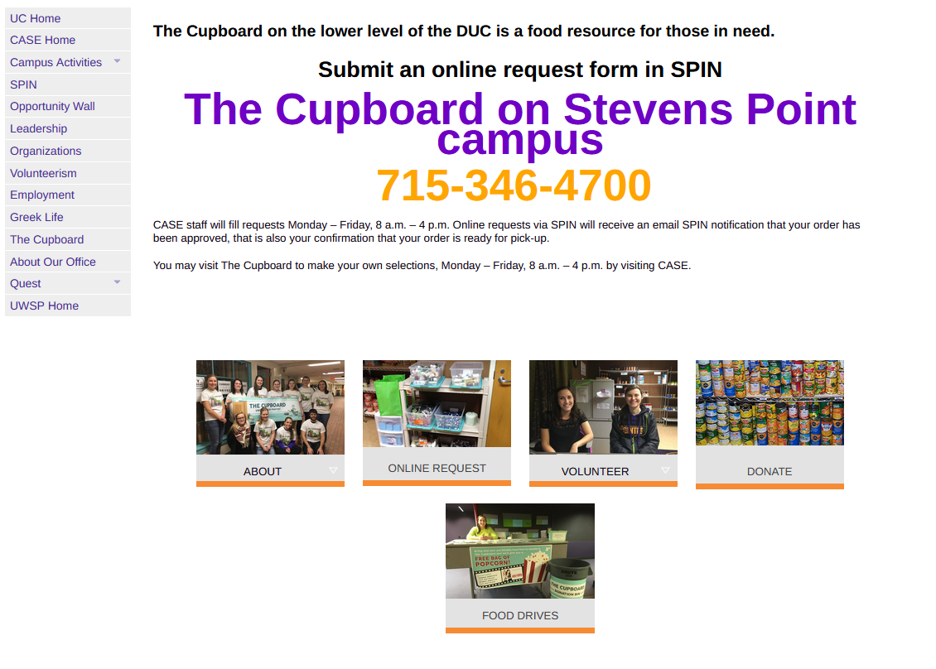
Redesign – The Cupboard

Slide 6
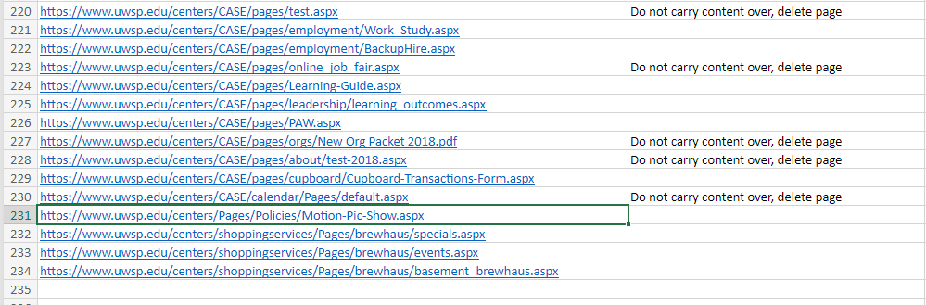
SharePoint Clean-Up

Slide 7
Challenges
Restricted from access to pages and content
Site Mapping
Additional peer-review steps

Slide 8

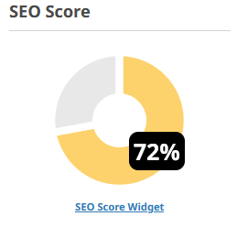
Measures
Department Approval of Pages
SEO Score of 75+
SharePoint Excel Sheet

